Slide 1
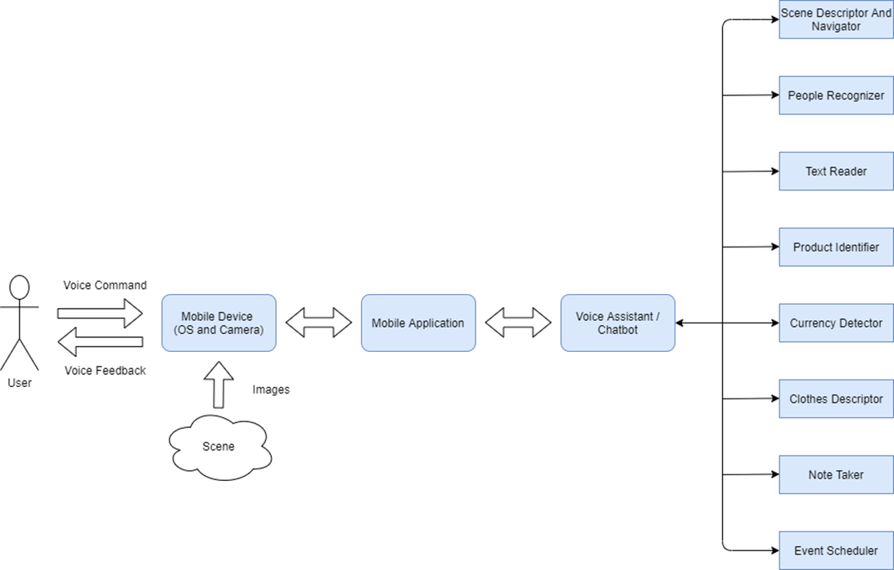
Pocket Lens GP 1 Presentation
Team 2 members:
Moaaz Mohamed Elsherbini 1180528
MOSTAFA ASHRAF kamAL 1180406
Nader yohanna adib 1180477
Ahmed Mohamed Ismail 1180501

